Slide 1

Spring Fundamentals
MWD

Slide 2
Agenda
Why Spring
Some design concepts
Basic core concepts
Some spring core annotation
Spring unit test
Exercise

Slide 3
Problems
Testability
Maintainability
Scalability
Complexity
Business Focus

Slide 4
Why Spring?
Spring makes programming Java quicker, easier, and safer for everybody. Spring’s focus on speed, simplicity, and productivity has made it the world's most popular Java framework (https://spring.io/why-spring)
From configuration to security, web apps to big data—whatever the infrastructure needs of your application may be, there is a Spring Project to help you build it. Start small and use just what you need—Spring is modular by design (https://spring.io/projects )

Slide 5
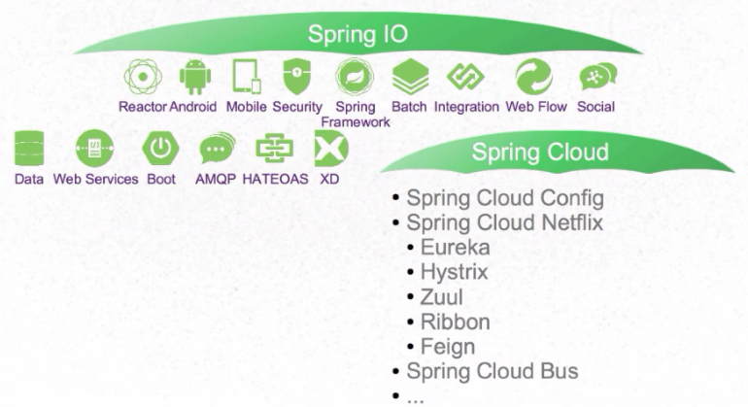
Spring Projects

Slide 6
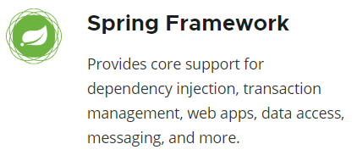
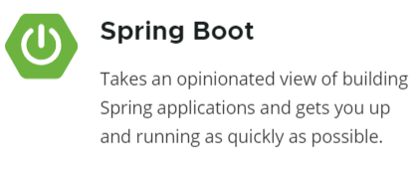
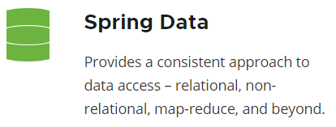

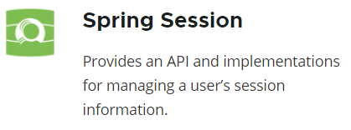
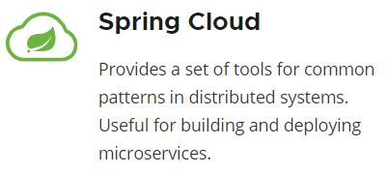
Spring Projects

Slide 7
Principle of Spring
Inversion of Control (IoC)
Dependency Injection
Aspect Oriented Programming
Modular Design

Slide 8

Inversion of Control (IoC)
IoC inverts the flow of control as compared to traditional control flow. In IoC, custom-written portions of a computer program receive the flow of control from a generic framework. A software architecture with this design inverts control as compared to traditional procedural programming: in traditional programming, the custom code that expresses the purpose of the program calls into reusable libraries to take care of generic tasks, but with inversion of control, it is the framework that calls into the custom, or task-specific, code. (wiki)
Example
print “enter your name”
read name
…
store in DB
No IoC IoC
MS-DOS: your code control the
flow of user interaction
GUI Application: window control the
flow of user interaction using events
Notes:
IoC is a key part of what makes a framework different to a library. A library is essentially a set of functions that you can call, these days usually organized into classes. Each call does some work and returns control to the client.
A framework embodies some abstract design, with more behavior built in. In order to use it you need to insert your behavior into various places in the framework either by subclassing or by plugging in your own classes. The framework's code then calls your code at these points. (martin fowler)

Slide 9
Inversion of Control (IoC)
Benefits
Loose coupling ➔ easier to reuse, test, maintain and extend.
Greater modularity of a program
Centralized configuration
Take care of long nested dependency chains and lifetime of dependencies
Disadvantages
Hard to debug and figure out the flow of the application
Performance issues, especially in environments that do not support multi-thread

Slide 10
IoC - DI
IoC
principal
pattern
Service Locator
Events
Delegates
Dependency Injection (DI)
Constructor Injection
Dependency Injection (DI) is a design pattern used to implement IoC. It allows the creation of dependent objects outside of a class and provides those objects to a class through different ways. Using DI, we move the creation and binding of the dependent objects outside of the class that depends on them.
Setter Injection
Interface Injection

Slide 11
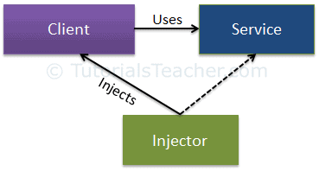
DI
Client class: The client class (dependent class) is a class which depends on the service class.
Service Class: The service class (dependency) is a class that provides service to the client class.
Injector Class: The injector class injects the service class object into the client class.
➔ The injector class creates an object of the service class, and injects that object to a client object.

Slide 12
Modular Design
Modular design is a design principle that subdivides a system into smaller parts called modules, which can be independently created, modified, replaced, or exchanged with other modules or between different systems.
Easy to customize products
Faster to market
Cost efficiency
Sustainability
Allows incremental upgrades

Slide 13
Aspect-Oriented Programming
Aspect-Oriented Programming (AOP) is a programming paradigm which complements Object-Oriented Programming (OOP) by separating concerns of a software application to improve modularization (Spring doc).
OOP: key modularity is the class
AOP: key modularity is the aspect
Before AOP
After AOP
User Service
Admin Service
User Service
Admin Service
Security
Transactions
Logging
Security
Transactions
Logging
Security
Transactions
Logging
Cross-cutting concerns (Aspects)

Slide 14
AOP Concepts
Aspect: a modularization of a concern that cuts across multiple classes.
Joint point: a point during the execution of a program, such as the execution of a method (Spring) or the handling of an exception.
Advice: action taken by an aspect at a particular join point: before, after returning, after throwing, after finally, around
Pointcut: a predicate that matches join points.
Target object (advised object): object being advised by one or more aspects.
AOP proxy: an object created by the AOP framework in order to implement the aspect contracts.
Weaving: linking aspects with other application types or objects to create an advised object. This can be done at compile time, load time, or at runtime (Spring).

Slide 15
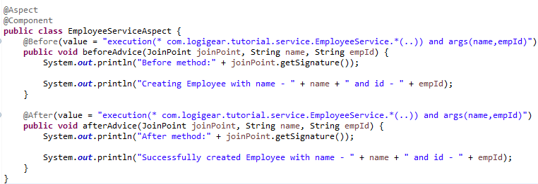
AOP in Spring Sample
Source: \doc\material\demo\Chapter 1\AOPSample

Slide 16
Basic concepts
Annotation
POJO & POJI
Spring Bean
Spring Container

Slide 17
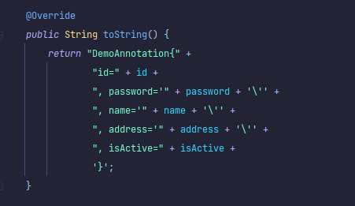
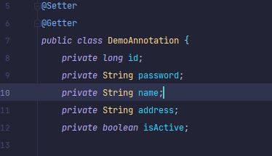
Annotation
1.1 Annotation in Java
Annotations, a form of metadata, provide data about a program that is not part of the program itself. Annotations have no direct effect on the operation of the code they annotate (oracle).
Annotations have a number of uses, among them:
Information for the compiler: Annotations can be used by the compiler to detect errors or suppress warnings.
Compile-time and deployment-time processing: Software tools can process annotation information to generate code, XML files, and so forth.
Runtime processing: Some annotations are available to be examined at runtime.

Slide 18
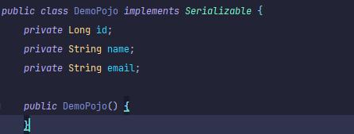
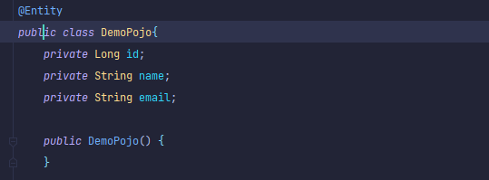
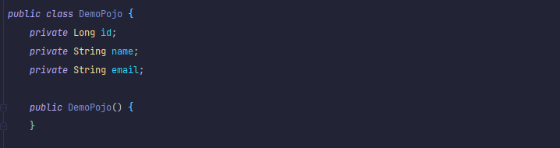
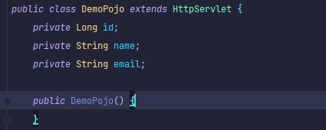
POJO & POJI
2.1 POJO Overview
Not POJO (Implement
prespecified interfaces)
POJO stands for Plain Old Java Object. It is an ordinary Java object, not bound by any special restriction other than those forced by the Java Language Specification and not requiring any class-path.
Not POJO (Contain
prespecified annotations)
This is a POJO
Not POJO (Extend
prespecified classes)

Slide 19
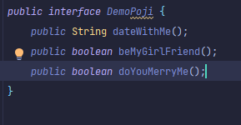
2. POJO & POJI
2.2 POJI Overview
If a java interface is not coupled with any technology (or) any frame work then such java interface is called “POJI” (plain old java interface)

Slide 20
3. Spring Bean
3.1 Overview
Spring Bean is nothing special, any object in the Spring framework that we initialize through Spring container is called Spring Bean. Any normal Java POJO class can be a Spring Bean if it’s configured to be initialized via container by providing configuration metadata information.

Slide 21
3. Spring Bean
3.2 Bean Scopes
Scope | Description
singleton | Scopes a single bean definition to a single object instance per Spring IoC container.
prototype | Scopes a single bean definition to any number of object instances.
request | Scopes a single bean definition to the lifecycle of a single HTTP request; that is each and every HTTP request will have its own instance of a bean created off the back of a single bean definition. Only valid in the context of a web-aware Spring ApplicationContext.
session | Scopes a single bean definition to the lifecycle of a HTTP Session. Only valid in the context of a web-aware Spring ApplicationContext.
global session | Scopes a single bean definition to the lifecycle of a global HTTP Session. Typically only valid when used in a portlet context. Only valid in the context of a web-aware Spring ApplicationContext.

Slide 22
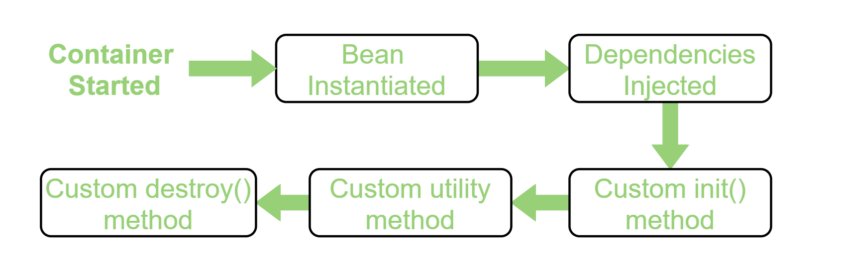
3. Spring Bean
3.3 Spring Bean life cycle
3.3.2 Spring Bean Life-Cycle
Bean life cycle is managed by the spring container.
When we run the program then, first of all, the spring container gets started. After that, the container creates the instance of a bean as per the request and then dependencies are injected.
And finally, the bean is destroyed when the spring container is closed.

Slide 23
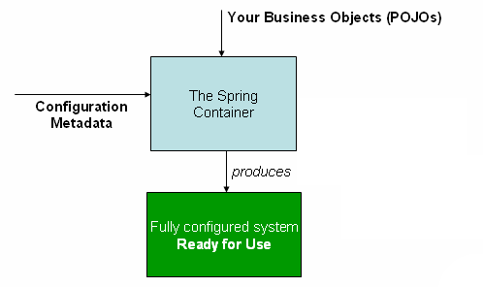
4. Spring Container
The org.springframework.context.ApplicationContext interface represents
the Spring IoC container and is responsible for instantiating, configuring, and assembling the beans.
The container gets its instructions on what objects to instantiate, configure, and assemble by reading configuration metadata.
The configuration metadata is represented in
XML
Java annotations
Java code
The Spring IoC container (spring.io)

Slide 24
Development Tools
Frontend
VSCode
Angular CLI
NPM
Backend
Eclipse/SpringToolSuite
MVN
OpenJDK 16

Slide 25
Lombok
A library that generates Java code based on annotations. It keeps the code samples concise, reducing the boilerplate so the reader can focus on what it matters.
Homepage: https://projectlombok.org/

Slide 26
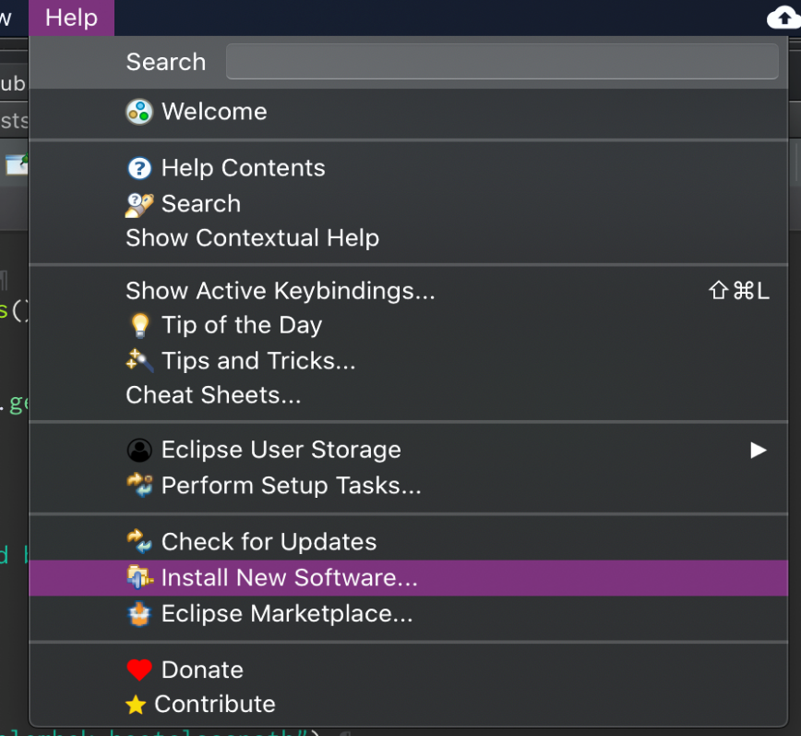
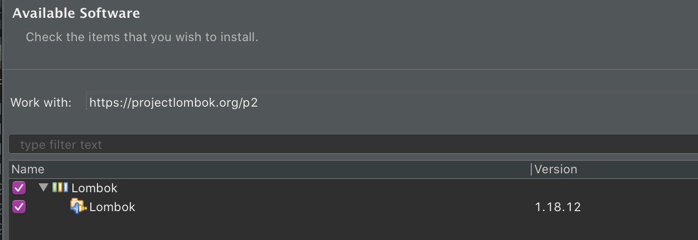
Install Lombok
1. Install via eclipse plugin installer: Help/Install New Software…
2. Use update site https://projectlombok.org/p2

Slide 27
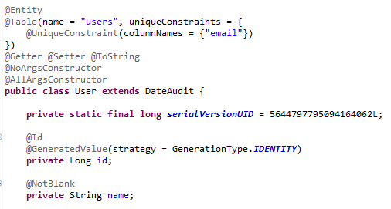
Use Lombok
By adding the @Getter, @Setter, @ToString annotations we told Lombok to, well, generate these for all the fields of the class.
@NoArgsConstructor will generate a constructor with no parameters.
@AllArgsConstructor generates a constructor with 1 parameter for each field in your class.

Slide 28
Important Spring Annotations
@Configuration
@ComponentScan
@Component
@Service
@Autowired
@Bean

Slide 29
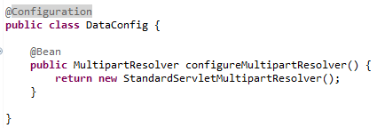
@Configuration
Mark a class as a source of the bean definition.
Is a component of the system that you want to wire together.
Methods must have the @Bean annotation to mark it as a bean producer.
@Bean - indicates that a method produces a bean to be managed by the Spring container.

Slide 30
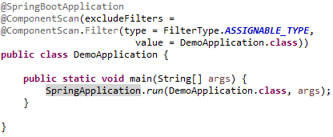
@ComponentScan
Leverage a normal Java class to a Spring bean.
Can be auto-scanned by the Spring Boot Application during the start-up time.
Can be used to inject wherever Spring framework need.

Slide 31

@Component
Leverage a normal Java class to a Spring bean.
Can be auto-scanned by the Spring Boot Application during the start-up time.
Can be used to inject wherever Spring framework need.

Slide 32
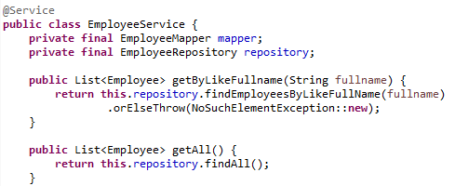
@Service
Act as a normal @Component annotation and has the same functions.
It tells Spring that it's safe to manage them with more freedom than regular components
Holding business logic, no encapsulated state

Slide 33



@Autowired
Can be used to inject appropriate Spring bean into the application parts.
Three ways to use the annotation: Field-level, Method-level, Setter-level.

Slide 34
Summary
Overview of Spring ecosystem
Basic concepts of spring
Basic Spring annotations
Tools and IDE
Sample
Exercise

Slide 35

Thank You!

